Slide 1
Optimal Economy
Phillip Tussing

Slide 2
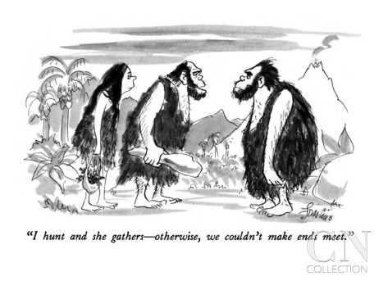
The Paleolithic: Hunter-Gatherer Economy
Two principles:
One: that women are (usually) the principle gatherers (80% of calories)
Two: that roles aren't fixed in stone
Life is short (usually <30 years on average)
But Nutrition is varied and Disease is Moderate
Women’s Status High

Slide 3
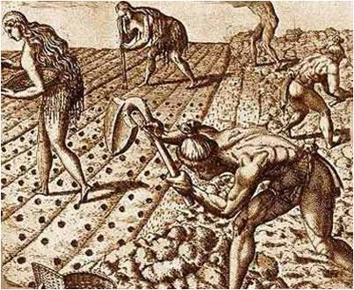
Agriculture supplemented by Pastoralism: approx 10,000 BC-1750
Nutrition Worse than Among Hunter-Gatherers – subsistence monoculture
Disease More Common
Life about as long: average <30 years on average
Security Greater – Rise of Soldiers
Fertility Higher: Women as Mothers of Workers; Status Low

Slide 4
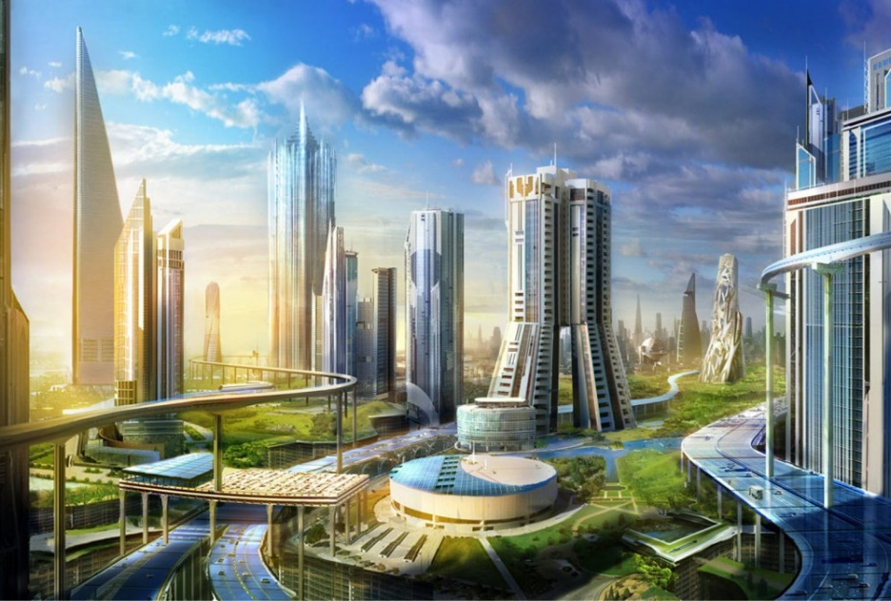
Models of a Perfect Economy
-Have been around for a long time.
In about 380 BC, the Greek philosopher Plato wrote a dialogue called The Republic, in which his mentor Socrates described an ideal just government in an ideal city-state.
Socrates thought everyone should do the work they were best at – then they would be happy. They would be happy if they loved their work; they would have no input into how the government is run.
He thought not only property, but also wives and children should be held in common.

Slide 5
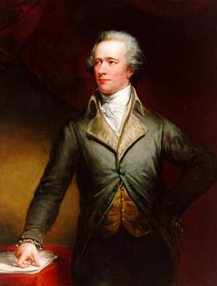
The United States as an Ideal Economy
-The Founders of the United States were wealthy and well-educated. They wanted to ensure that the country was open to business, that the national government was strong but not too intrusive, and that the scope for political influence by popular power was limited.
The Commerce Clause refers to Article 1, Section 8, Clause 3 of the U.S. Constitution, which gives Congress the power “to regulate commerce with foreign nations, and among the several states, and with the Indian tribes.” Its primary intent is to prevent states from imposing restrictions on commerce with other states or to conclude separate commercial treaties with other nations, so that the USA could become one continent-wide free market.
The American approach to private property was built around the ideas of John Locke, a 17th century British philosopher, who wrote: “Man being born, as has been proved, with a title to perfect freedom, and an uncontrouled enjoyment of all the rights and privileges of the law of nature, equally with any other man, or number of men in the world, hath by nature a power, not only to preserve his property, that is, his life, liberty and estate, against the injuries and attempts of other men; but to judge of, and punish the breaches of that law in others.” Locke considered the main duty of the police was to protect property.
Alexander Hamilton

Slide 6
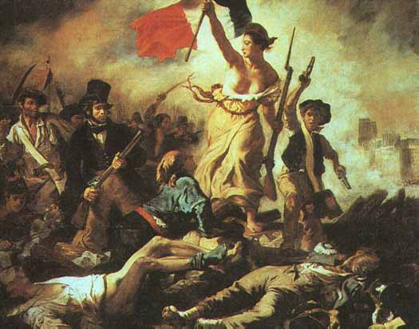
The French Revolution
Liberty, Equality, Fraternity: This was the slogan of the French Revolution in 1789, in which wealthy aristocrats were violently thrown out and replaced by a Republic, with most power in the hands of elected representatives of the common people.
The Revolutionary government nationalized the estates of aristocrats, as well as church lands. Urban guilds and their monopolies were abolished, and small businesses flourished. Due to the disruption to the old regime, the new one could never collect enough taxes to pay its bills, and so slipped into hyperinflation, which set the stage for the emergence of Napoleon as a dictator in 1799.

Slide 7
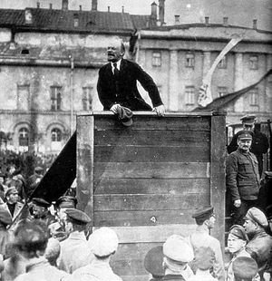
The Russian Revolution
Karl Marx wrote The Communist Manifesto, the foundational document of European Communist doctrine, in 1848, the same year as a failed Communist revolution in Paris. It was not until 1917 that a successful Communist revolution occurred – and this was not in an advanced country, as Marx had predicted; it was in the underdeveloped conditions of Russia. Vladimir Lenin, its leader, created the idea of a dictatorial government – the Soviet Union -- which was supposed to rule on behalf of the workers, and the old aristocratic order was overthrown. Under Joseph Stalin in the late 20s and 30s, agriculture was collectivized at a cost in lives of some 12 million people. The lack of a direct benefit to people from their labor, and the channeling of benefits through government bodies, were huge incentives to slacking and to corruption. The Soviet empire collapsed in 1989.

Slide 8
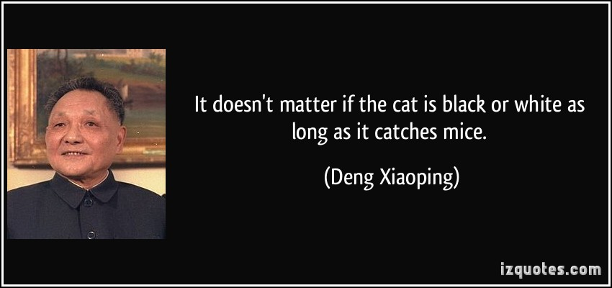
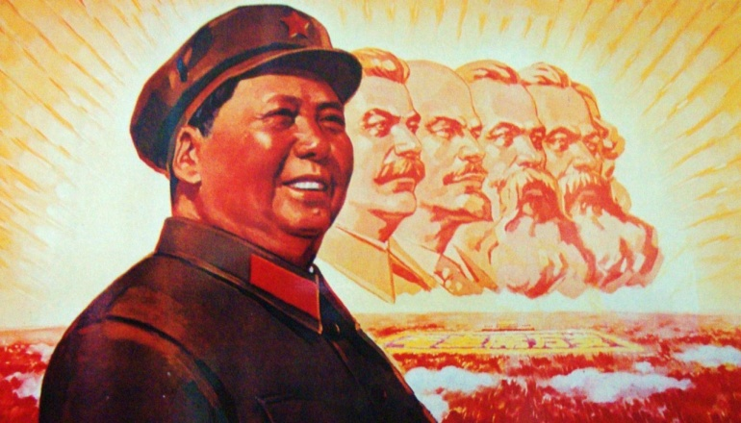
China Under Mao; & Under Deng
-Ideology
-Communist state-ownership of means of production
-”Great Leap Forward” in the 50s: Collectivization & Industrialization – approx 30 million people died.
-Pragmatism
-Mixed State & Private Ownership
-Adopted Japanese-style “Export-led Growth” model
-Economic growth on average 1979-2013 of 9.5%/yr

Slide 9
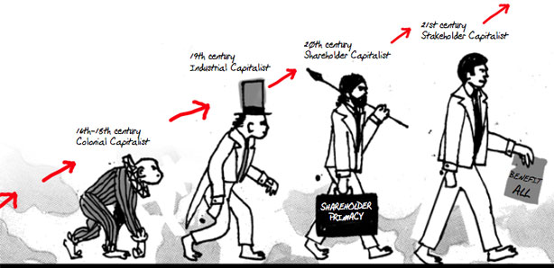
Systems: Capitalism/
Market Economy
-Ownership of means of production by wealthy “capitalists”, who own “capital”, which is the means of production
-Characterized by “economic freedom”, which in practice is more available as one’s wealth increases
-Evolution from early Capitalism in which capitalists exercised monopoly power over easily replaced workers, to 21st century industries in which highly trained work force is the primary and hard-to-replace resource of production; power of labor Demand (Capitalists) and Supply (Skilled labor) more balanced. Unskilled or Low-Skilled workers have much less power.
-Main problem: Inequality of Income & of Wealth
-Second problem: Increasing concentration of industries (oligopolization)

Slide 10
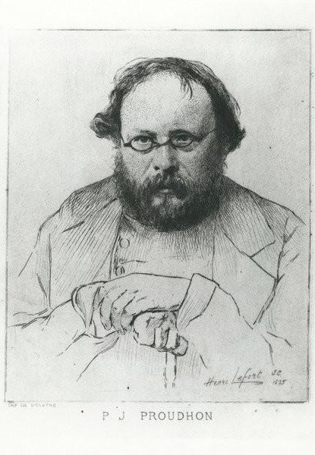
Systems: Mutualism
-Created by Pierre-Joseph Proudhon, in his 1840 book “What is Property?”
-Promoted mutual financial cooperation among workers. He believed this would transfer control of economic relations from capitalists and financiers to workers.
Proposed the establishment of a bank to provide credit at very low rates of interest.

Slide 11

Systems: Communism
-Worker ownership of means of production – taken away from previous Capitalist owners
-Collective ownership, also collective benefits: “From each according to his capacity; to each according to his need” – distributed by a workers’ collective
-Built-in Incentives for workers to be slackers, because they do not benefit from increased productivity, and for those who distribute benefits to become corrupt, because they are making subjective assessments of what consumers “deserve”
-Response to highly trained workers was often to tell them to work with no additional benefits: the concept was that workers would work voluntarily for the collective: rarely happens in practice

Slide 12
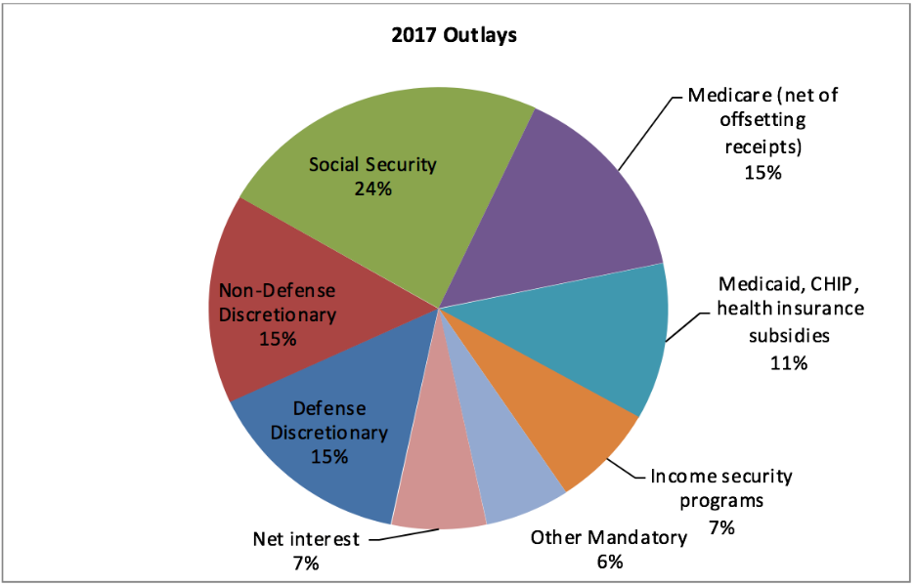
Systems: Social Democratic/Statist
-Social Democratic/Statist/Welfare State/ Nanny State: “a political, social and economic ideology that supports economic and social interventions to promote social justice within the framework of a capitalist economy, and a policy regime involving collective bargaining arrangements, a commitment to representative democracy, measures for income redistribution, regulation of the economy in the general interest and welfare state provisions.”
-Applicable to various degrees to most rich country economies since the 1940s or earlier – especially applicable to France, for which government spending at all levels is 56% of GDP, or Denmark (58%); somewhat less so to the US (42%).

Slide 13
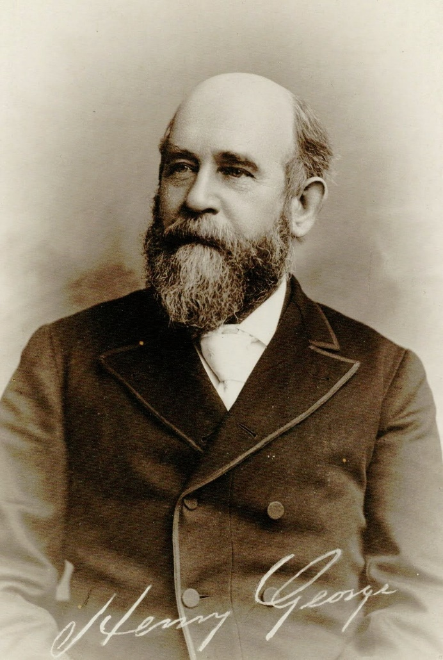
Systems: Georgism/
Environmental Economics
Progress and Poverty, 1979
-Land should not be monopolized by capitalists – it should be owned by the state and rented, or at least owned by individuals and taxed according to its rental value
-Has been adopted by environmentalists, such as Herman Daly a former Senior Economist at the World Bank, for Environmental Economics
http://www.thesocialcontract.com/artman2/publish/tsc1303/article_1138.shtml

Slide 14
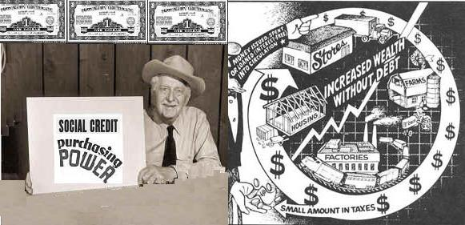
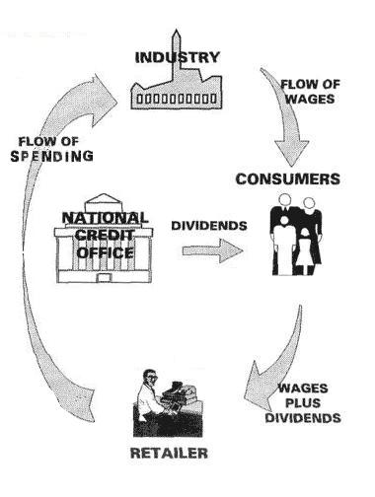
Systems:
Social Credit
-Founded by Scottish engineer, C.H. Douglas, in 1924
-”Social Dividend” paid to all because inherited technology belongs to entire society
-complicated “A+B Theorem” regarding how bank credit leads to inflation
-Political parties in Alberta Canada, Australia & New Zealand
http://www.socred.org/s-c-action/social-credit-views/the-economics-of-social-credit-in-summary/social-credit-explained-in-7-points

Slide 15

Systems: Libertarianism
-Libertarianism is “a political philosophy that upholds liberty as its principal objective. Libertarians seek to maximize autonomy and freedom of choice, emphasizing political freedom, voluntary association, and the primacy of individual judgment.”
-Usually prefers minimal government (security functions only) and laissez-faire capitalism or sometimes limits on big business.
-Ayn Rand a proponent of “monarchism”, a brand of libertarianism
-Ron Paul, US Presidential candidate in 2012, has libertarian tendencies.

Slide 16
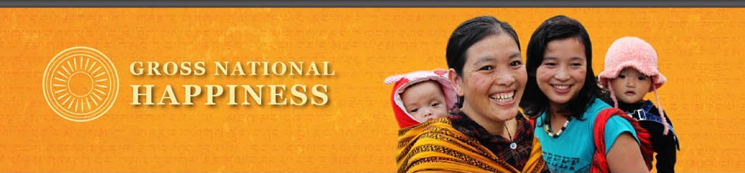
Buddhist Economics
Bhutan, a small Himalayan kingdom, introduced a measure called “Gross National Happiness”. Its former king, inspired a movement built on four pillars:
Sustainable Development
Preservation & Promotion of Cultural Values
Conservation of the Natural Environment
Establishment of Good Governance
This depends less on a particular economic system and more on psychological indicators of well-being, which in practice is self-reported. The problem is that it is hard to measure.

Slide 17
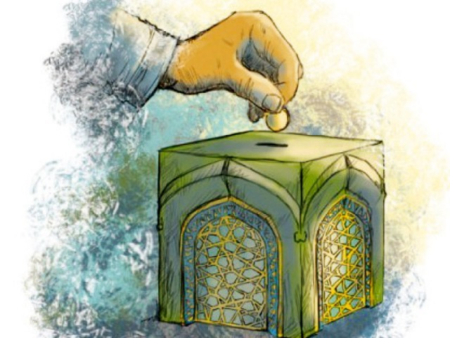
Islamic Economics
Built around three main aspects:
Rules of Islamic practice: reducing the gap between rich & poor, etc
Collection & Distribution of Islamic taxes – taxing wealth, not trade
Prohibition of Interest Payments; instead basing lending on profit sharing
Contrasting main examples:
-Saudi Arabia: country in which Islamic Economics has been most fully implemented, but dominated by an inherited ruling class
-Iran: domination by a state sector which is in turn ultimately ruled by the clerical class and supported by a paramilitary police – the Revolutionary Guard – which heavily benefits from economic activity.

Slide 18
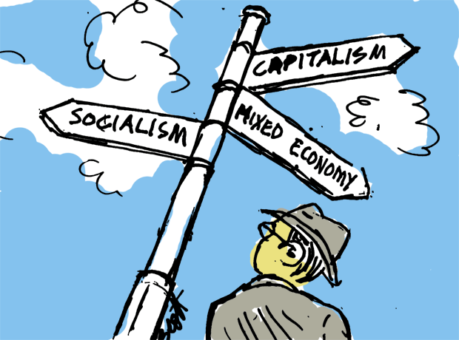
What Economic System Do You Prefer?
-All these systems are based on personal beliefs of what is “best”, so they are not “scientific” – therefore, there is no “best” choice. Capitalism is the most “efficient”, but it has other built-in problems.
Hunter-Gatherer
Agricultural Economy/Pastoralism
Capitalism, or Market Economy
Mutualism
Communism, or Socialism
Social Democracy
Georgism
Social Credit
9. Social Democracy
10. Social Credit
11. Libertarianism
12. Buddhist Happiness Economy
13. Islamic Economy

